Slide 1
Stanford ME469: High Performance Computing for CFD
Stefan P. Domino
Computational Thermal and Fluid Mechanics
Sandia National Laboratories SAND2018-4536 PE

Slide 2
High Performance Computing for CFD: Outline
Overview of Time and Length Scales
Fire
Wind
Conceptual Parallel Computing Model
Types of Scaling: Strong and Weak
Examples of Scaling
Next Generation Platform Exascale Drivers
Conclusions

Slide 3
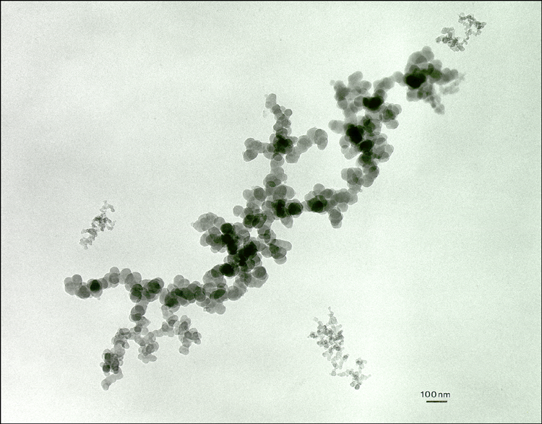
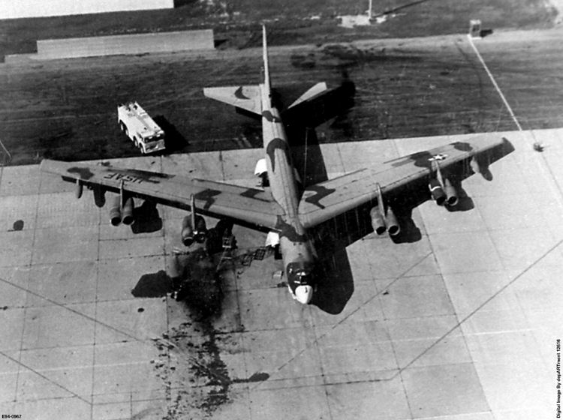
Disparity in Time and Length Scales, Fire
Engineering Scale of Interest
10³
Heat Transfer in Weapon
Convective Transport
10⁰
Convection
Time Scale, seconds
Products
10⁻³
Fuel Distribution
Soot
Flames
10⁻⁶
Soot Radiation
Chemical Kinetics
Diffusive Transport
Soot Growth
10⁻⁹
Molecular Radiation
Molecular Transport
10⁻¹²
10⁻¹⁰
10⁻⁸
10⁻⁶
10⁻⁴
10⁻²
10⁰
10²
Length Scale, meters

Slide 4
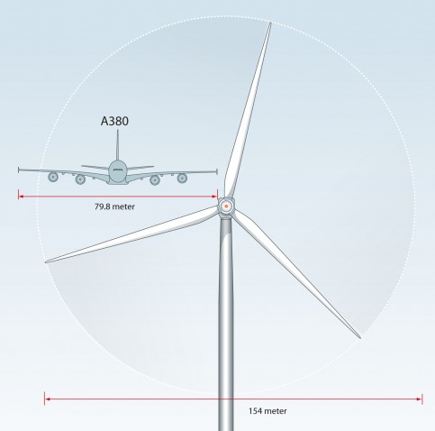
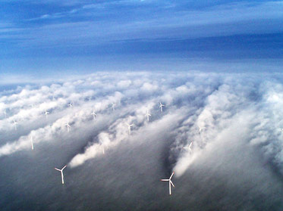
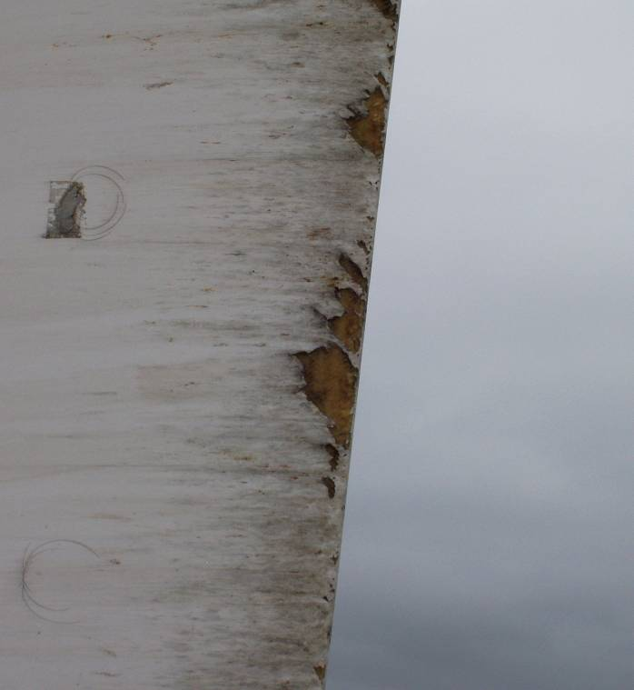
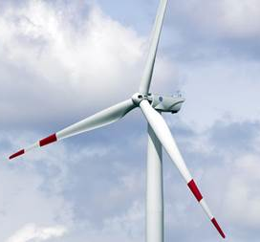
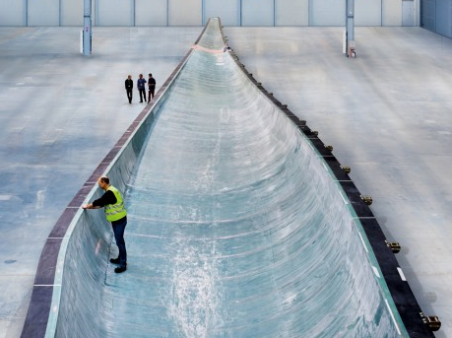
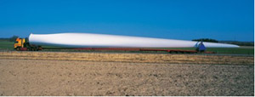
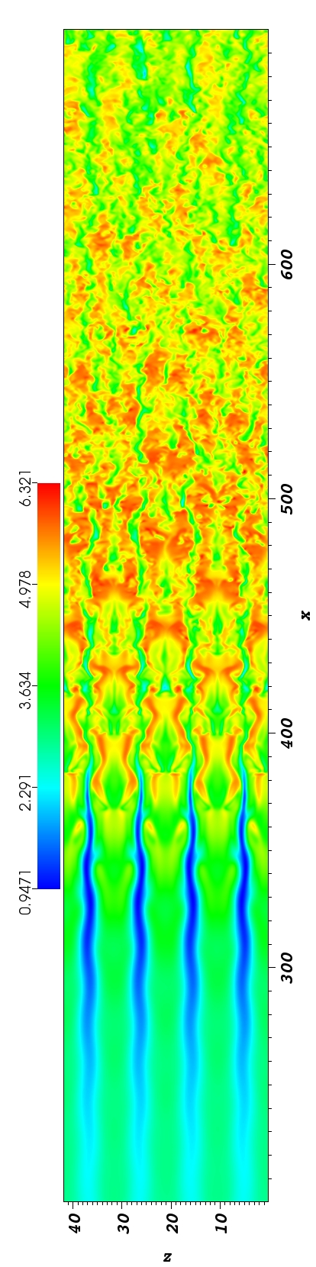
Disparity in Time and Length Scales, Wind
10³
Engineering Scale of Interest
Knight & Carver
Convective Transport
10⁰
Time Scale, seconds
Severe Leading Edge Erosion
10⁻³
Sound propagation (turbulent atmosphere and complex domains)
10⁻⁶
10⁻⁶
10⁻⁴
10⁻²
10⁰
10²
10⁴
Length Scale, meters

Slide 5
Conceptual Scaling Exercise
= 500 sq ft/day
Goal: Paint a house in one day
My House: 1000 sq ft
WH: 60,000 sq ft
One person would paint my house in two days (!!)
The white house will require one person 120 days (!!)
= 500 sq ft/day
Painting Rate Legend

Slide 6
Single House, More People (each person with reduced load)
= 500 sq ft/day
Goal: Paint a house in one day
My House: 1000 sq ft
WH: 60,000 sq ft
= 500 sq ft/day
Painting Rate Legend
+
= One day
+
+
+
= Faster Completion; Half day (each person 250 sq ft)

Slide 7
Single House, More People (with shared load)
= 500 sq ft/day
Goal: Paint a house in one day
My House: 1000 sq ft
WH: 60,000 sq ft
= 500 sq ft/day
Painting Rate Legend
+
= 60 days
( )
Time to completion is one day. Everyone
involved provided 500 sq ft
60x
+
= 1 day

Slide 8
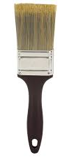
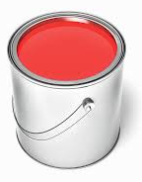

Single House, More People (with impediments)
= 500 sq ft/day
Impediments:
Peter’s team, who played basketball last night, have some injuries
Limited paint brushes…
Plenty of paint, poor loading capacity
No coherent plan of attack
= 500 sq ft/day
Painting Rate Legend
~ 250 sq ft/day
…
+
= 60 days
( )
60x
+
+
>> 1 day
n

Slide 9
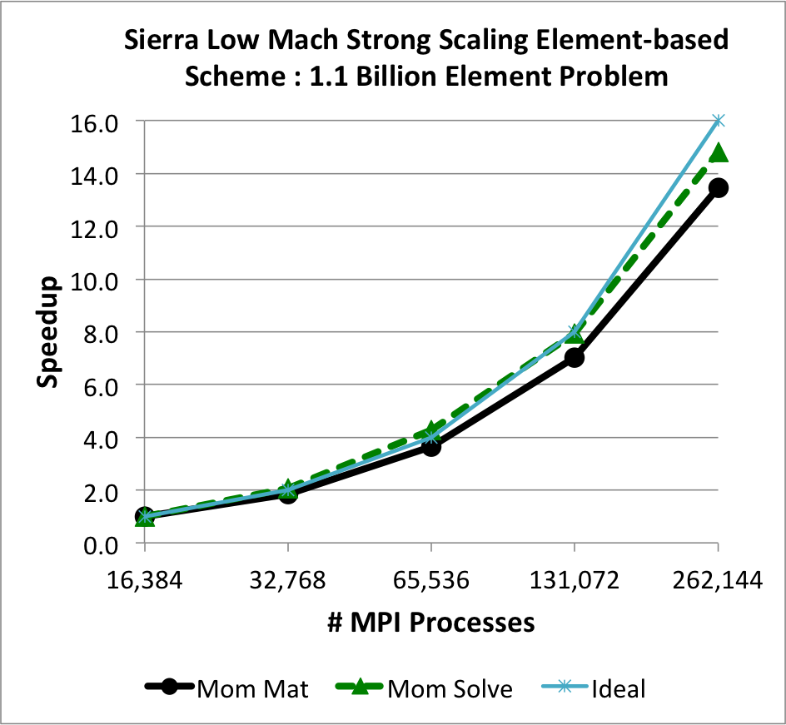
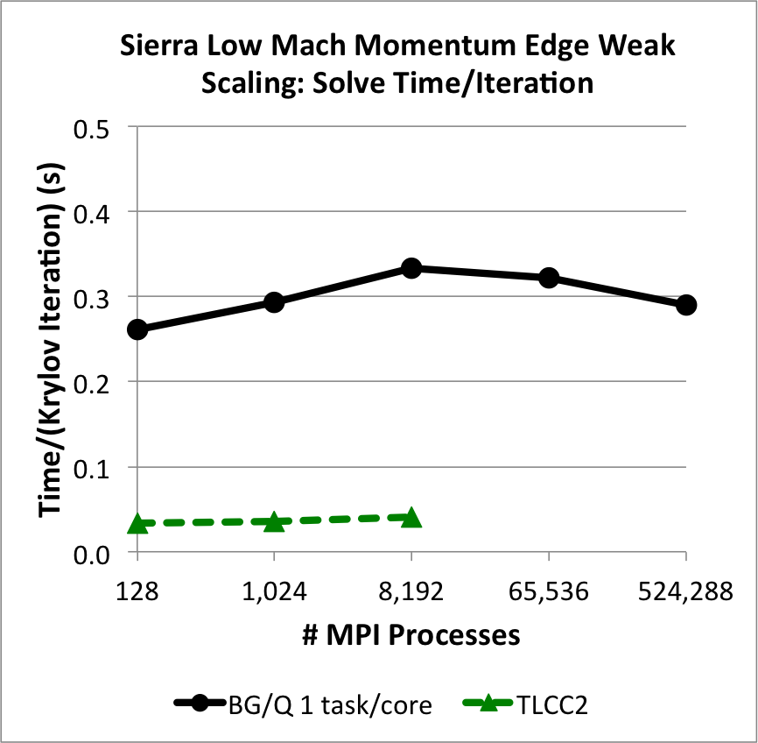
Types of Scaling
Strong Scaling: How the solution time varies with increased computational resources (cores, threads, GPU/Warps) on a fixed-size problem
User Y has a mesh that is 1 billion elements and would like to minimize the time it takes to complete a simulation; the larger the resource, the faster the turn-around
Weak Scaling: How the solution time varies with increased problem size on a fixed computational resource load (cores, threads, GPU/Warps)
User Y is conducting a validation study that includes three mesh resolutions, which were obtained by uniform mesh refinement, and would like to increase the computational resource appropriately for each subsequently refined mesh
Strong Scaling
Weak Scaling

Slide 10
Types of Scaling
Strong Scaling: How the solution time varies with increased computational resources (cores, threads, GPU/Warps) on a fixed-size problem
User Y has a mesh that is 1 billion elements and would like to minimize the time it takes to complete a simulation; the larger the resource, the faster the turn-around
Weak Scaling: How the solution time varies with increased problem size on a fixed computational resource load (cores, threads, GPU/Warps)
User Y is conducting a validation study that includes three mesh resolutions, which were obtained by uniform mesh refinement, and would like to increase the computational resource appropriately for each subsequently refined mesh
~4,000 elem/core
~8,000 elem/core
General Implicit Rules:
1e6 elem/node
~25k elem/core
Strong Scaling
Weak Scaling

Slide 11
Challenges Associated with Scaling
Consider a communication-intensive code procedure: Algebraic Multigrid (AMG) preconditioner setup
Like verification, the product of a first-time scaling study at a new production scale is generally met with work!
+
+
+
+
+
+
+

Slide 12
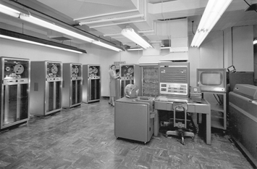
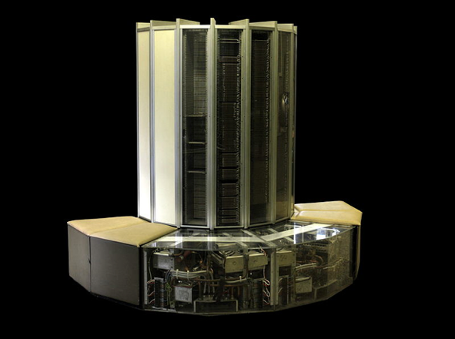
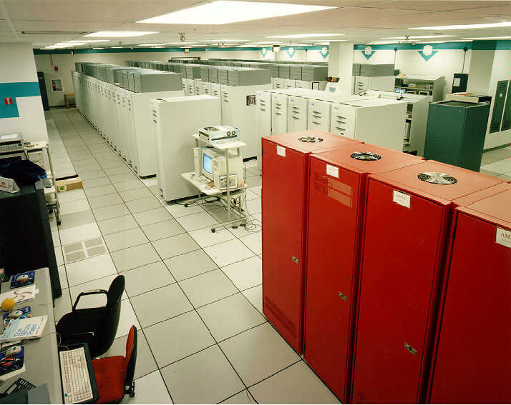
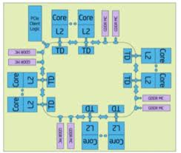
Computing Performance: Through the Years
HPC is facing a new disruption in technology
Mainframes
60’s to 70’s
Vector
Supercomputers
70’s to early 90’s
Massively parallel processor (MPP) systems with simple nodes
1990’s to 2010
MPP w/ Advanced Architecture nodes: Multilevel, heterogeneous, energy and memory constrained
ROOM → MACHINE → CABINET → CHIP
COMPLEXITY
Technology disruptions require a significant increase in complexity of our codes
Slides courtesy of Mike Glass, Jim Ang, Rob Hoekstra, Si Hammond, Ron Brightwell, and Stephen Olivier.

Slide 13
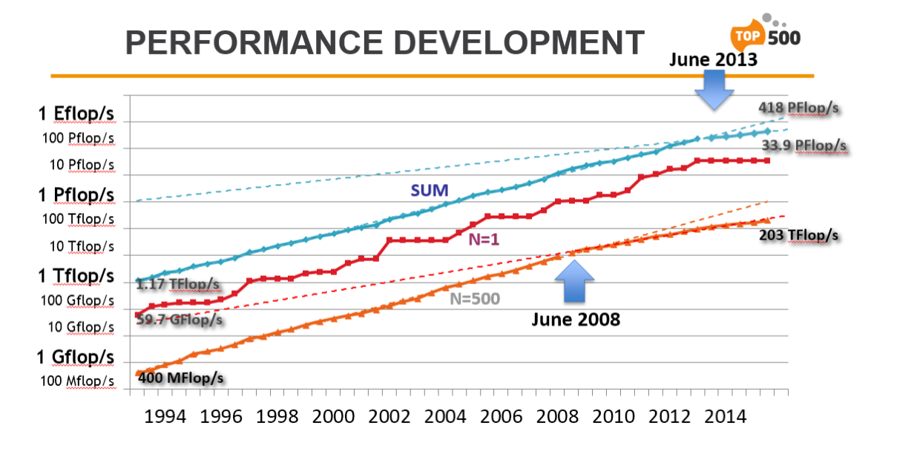
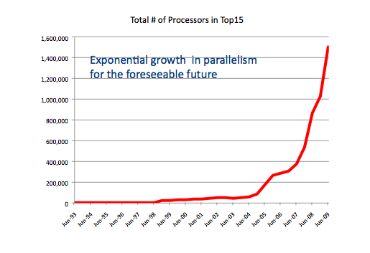
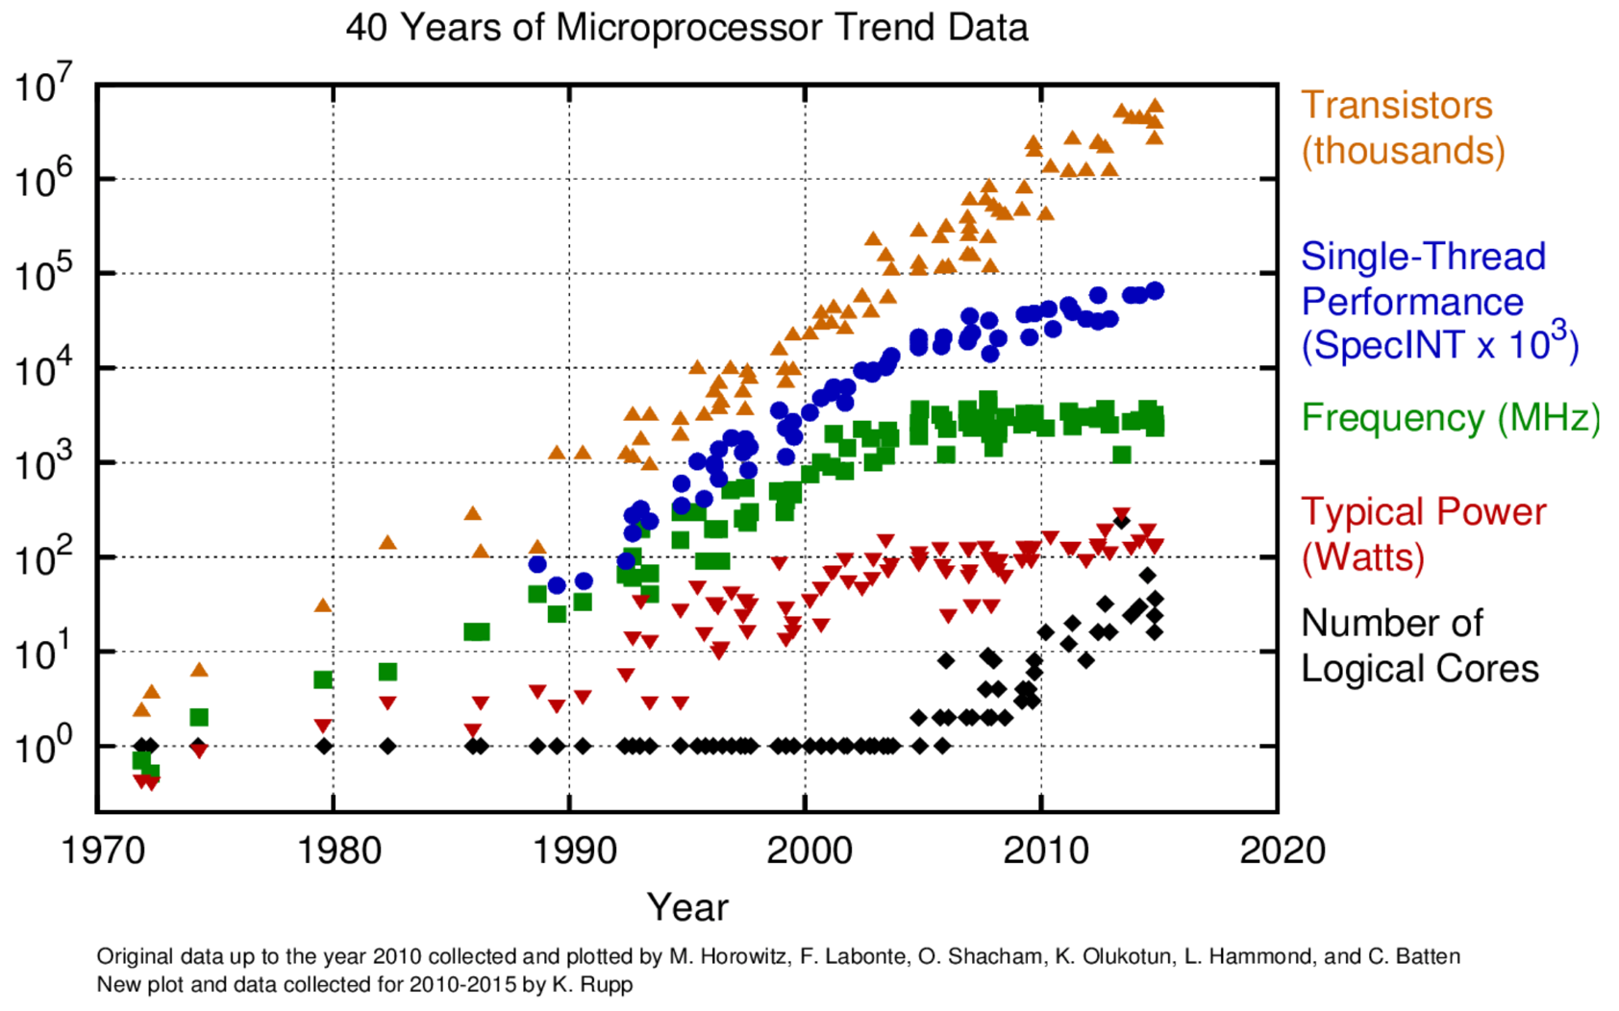
Drive Towards Next Generation Platforms
https://www.hpcwire.com/2015/11/20/top500/
Sequoia Parallelism = 5M
Cielo Parallelism = 100K
RATIO = 50
Dramatic increase in on-node parallelism and reduction in relative data movement is counter to our current code performance
Power constraints are driving the rapid increase in on-node parallelism.
However, per core memory bandwidth is decreasing making it extremely difficult to fully utilize additional cores
Slides courtesy of Mike Glass, Jim Ang, Rob Hoekstra, Si Hammond, Ron Brightwell, and Stephen Olivier.

Slide 14
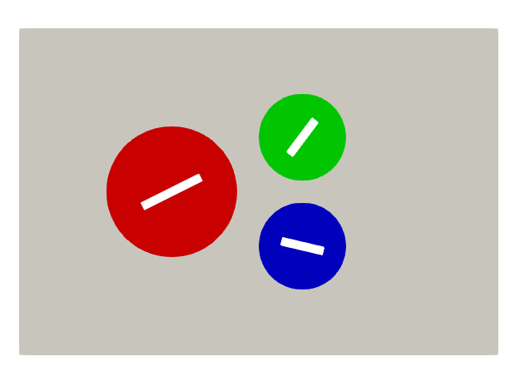
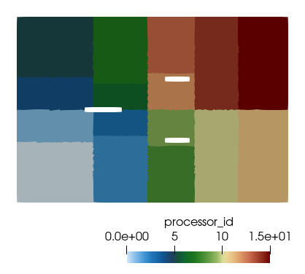
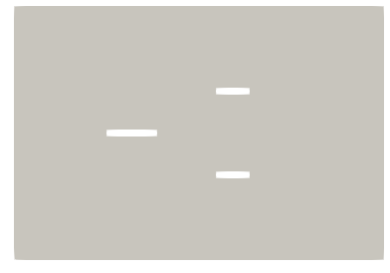
Nalu/reg_tests/test_files/dgNonConformalThreeBlade
Recall the first task assigned, dgNonConformalThreeBlade inclued the following line command within the input file:
- name: realm_1
automatic_decomposition_type: [type]
Colored by block ID
Colored by core count (= 1)

Slide 15
High Performance Computing for CFD: Conclusions
Several fluids applications found in the low-Mach application space require HPC
Strong and weak scaling are of interest in engineering analysis
Communication bottlenecks can affect scaling
From a user-perspective, scaling is critical to efficiently deploying production simulation results
Path towards NGP will require disruptive technology with significant code investments

